Slide 1
Initial Conditions
BY:
Asst. Prof. Uddhav Bhattarai
Cosmos College of Management and Technology

Slide 2
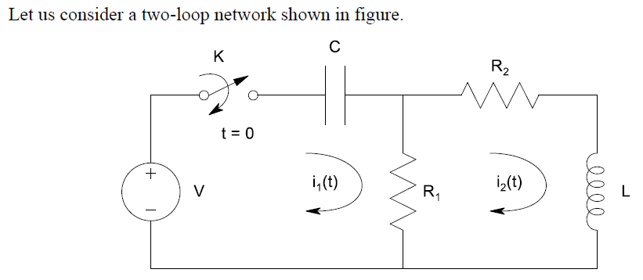
Initial Conditions_ Solutions

Slide 3
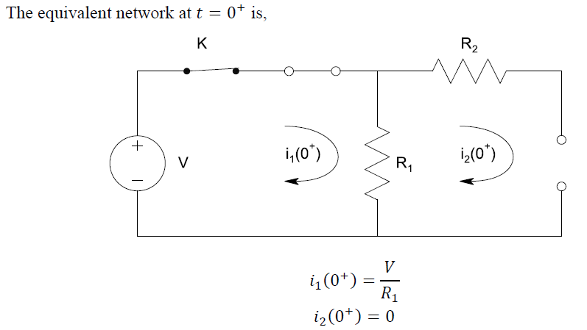
Initial Conditions_ Solutions Conti…

Slide 4
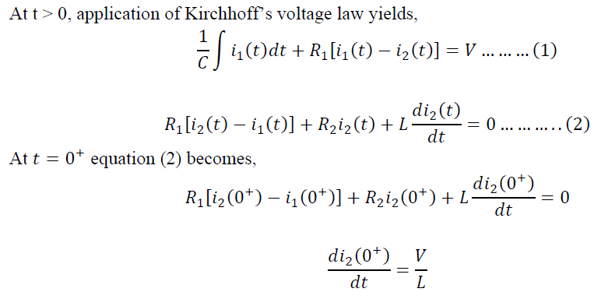
Initial Conditions_ Solutions Conti…

Slide 5
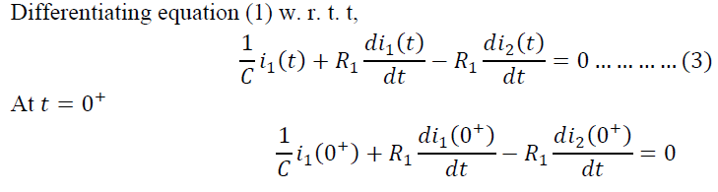
Initial Conditions_ Solutions Conti…

Slide 6
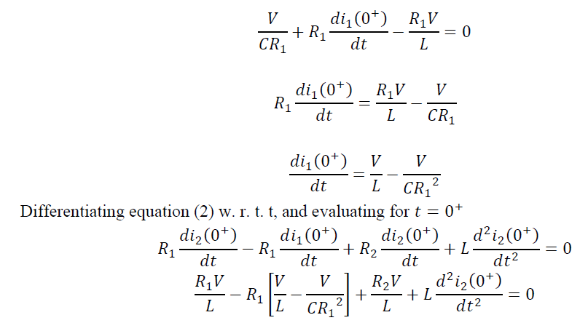
Initial Conditions_ Solutions Conti…

Slide 7
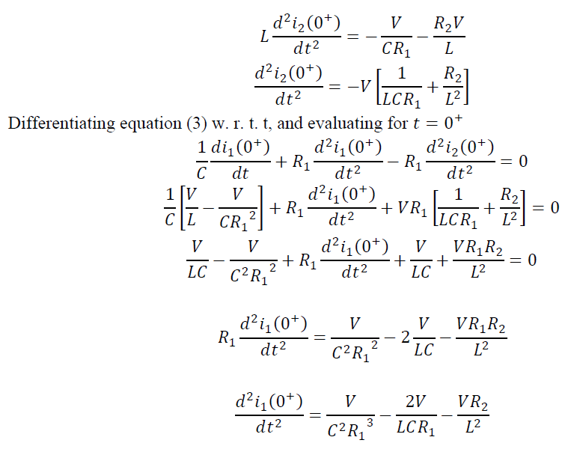
Initial Conditions_ Solutions Conti…

Slide 8
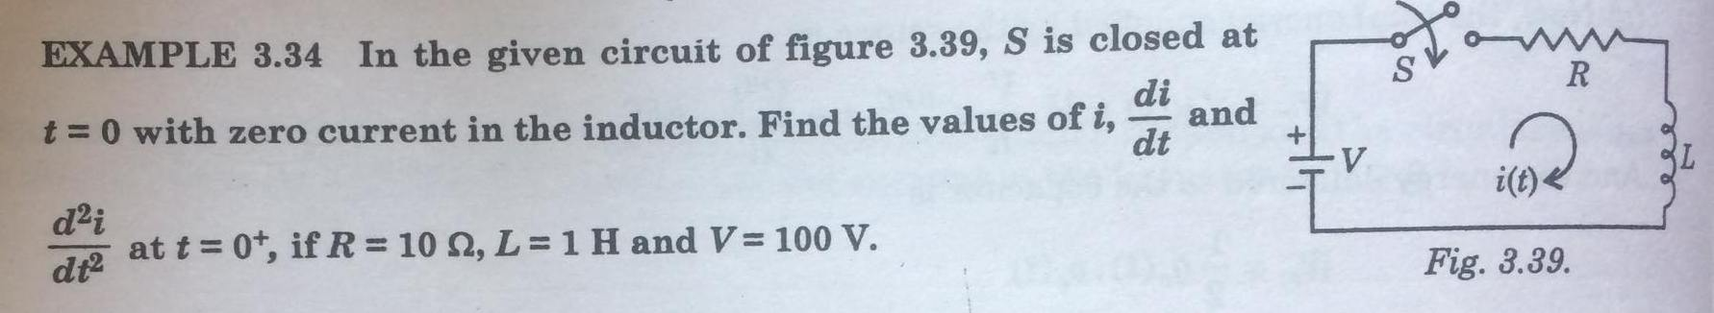
Initial Conditions_ Solutions Conti…

Slide 9
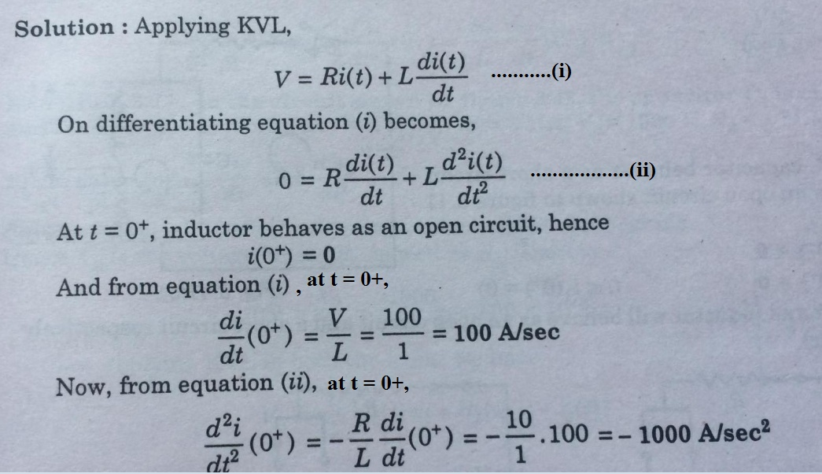
Initial Conditions_ Solutions Conti…

Slide 10
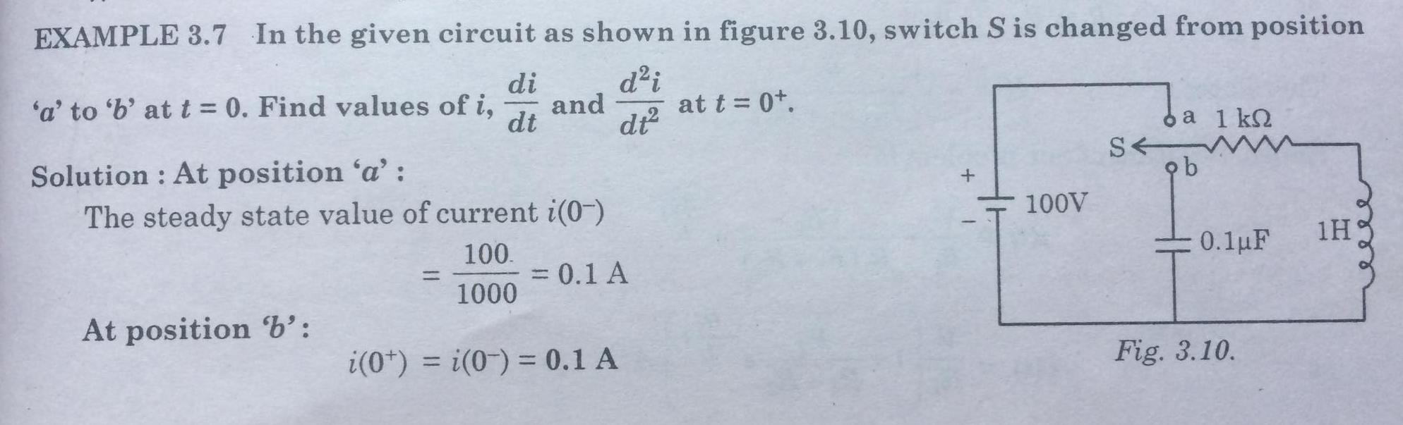
Initial Conditions_ Solutions Conti…

Slide 11
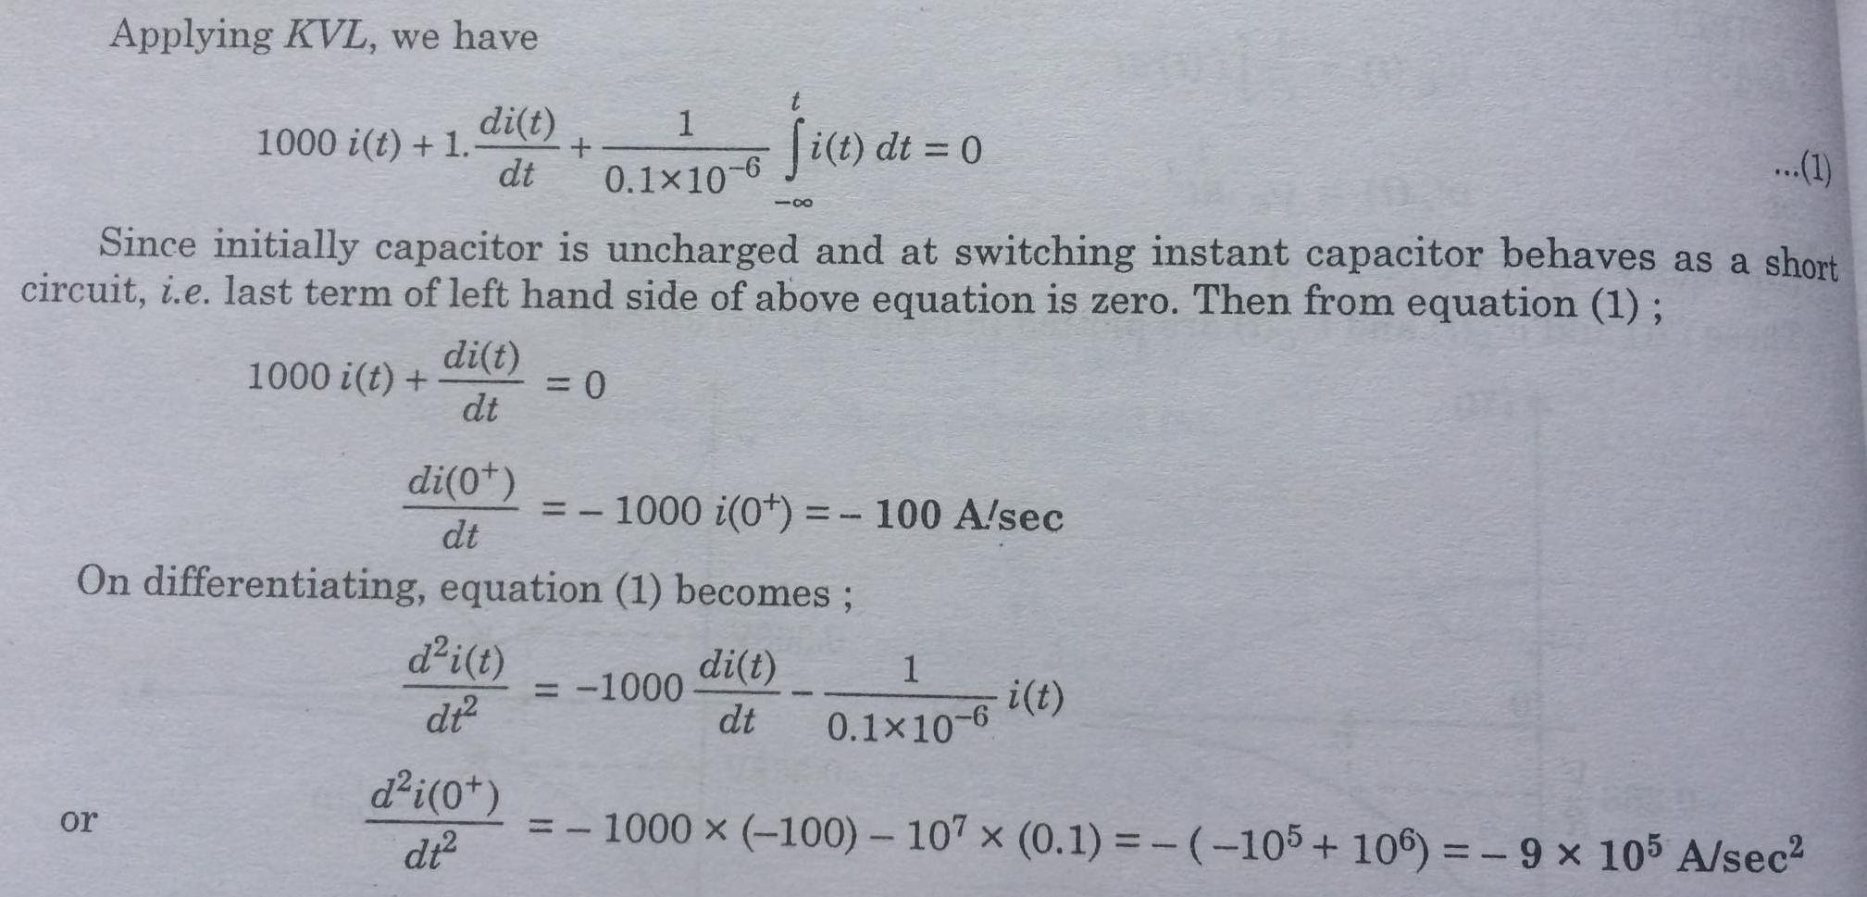
Initial Conditions_ Solutions Conti…

Slide 12
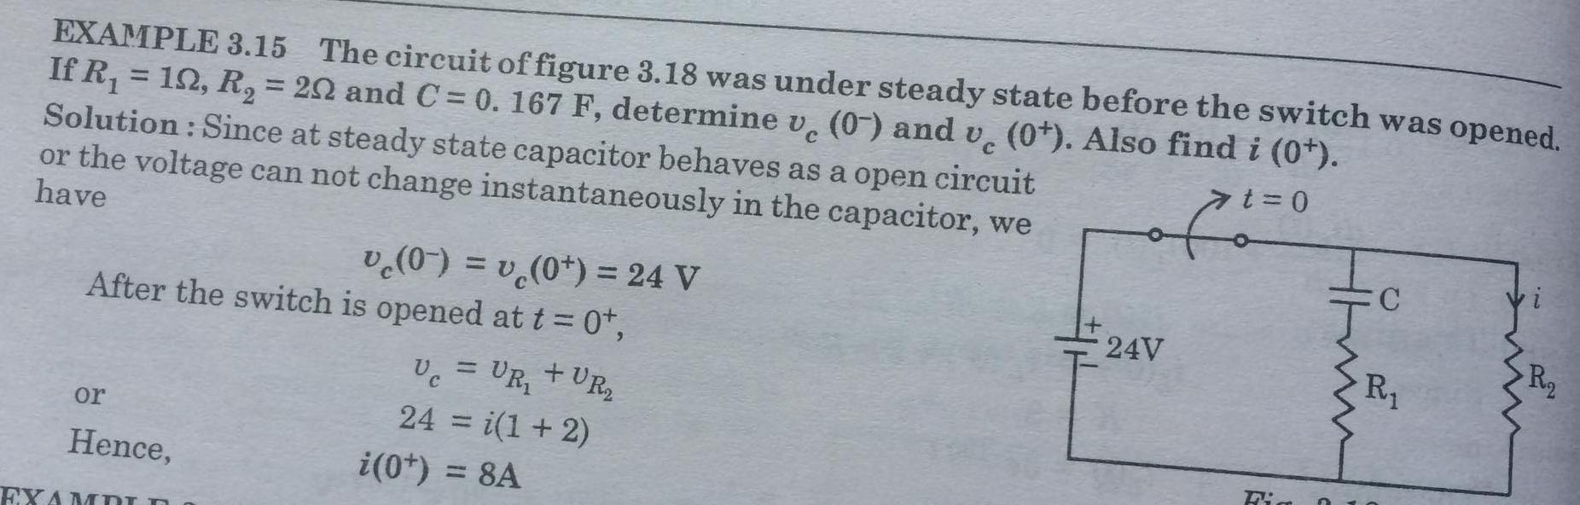
Initial Conditions_ Solutions Conti…

Slide 13
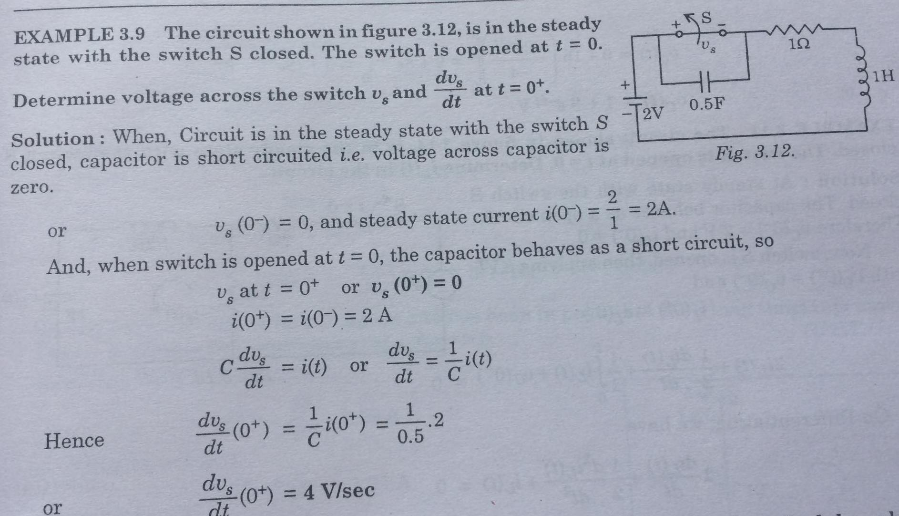
Initial Conditions_ Solutions Conti…

Slide 14
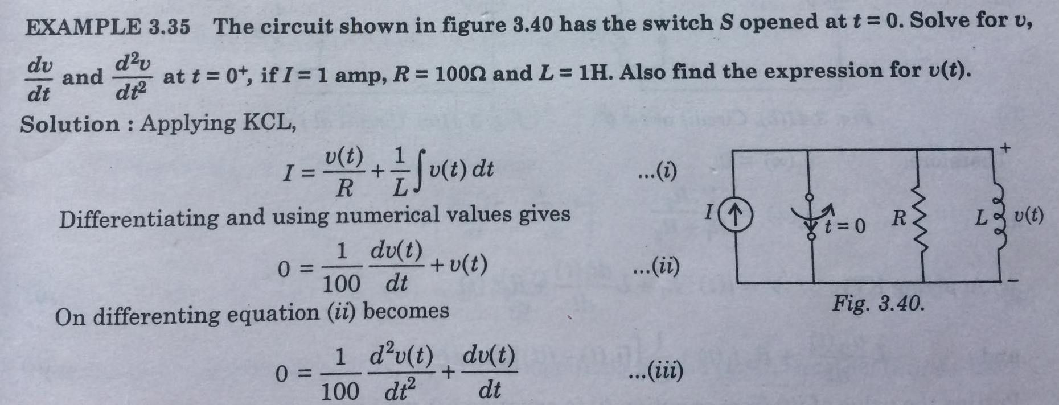
Initial Conditions_ Solutions Conti…

Slide 15
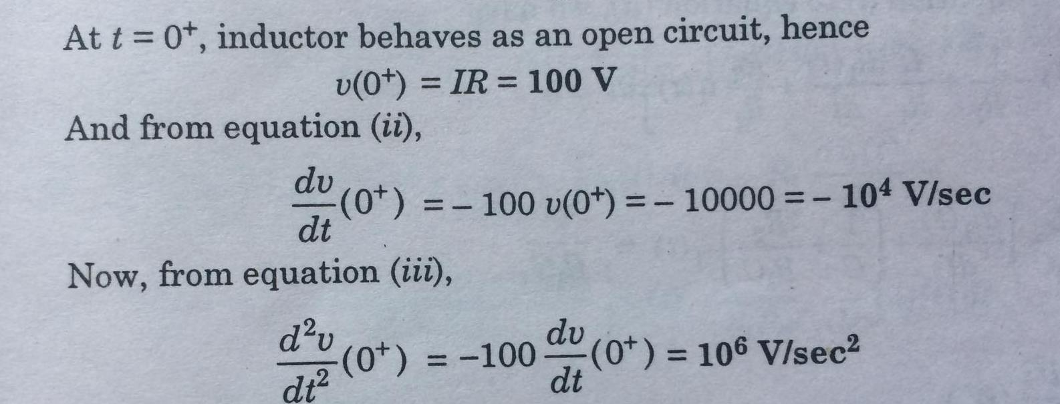
Initial Conditions_ Solutions Conti…

Slide 16
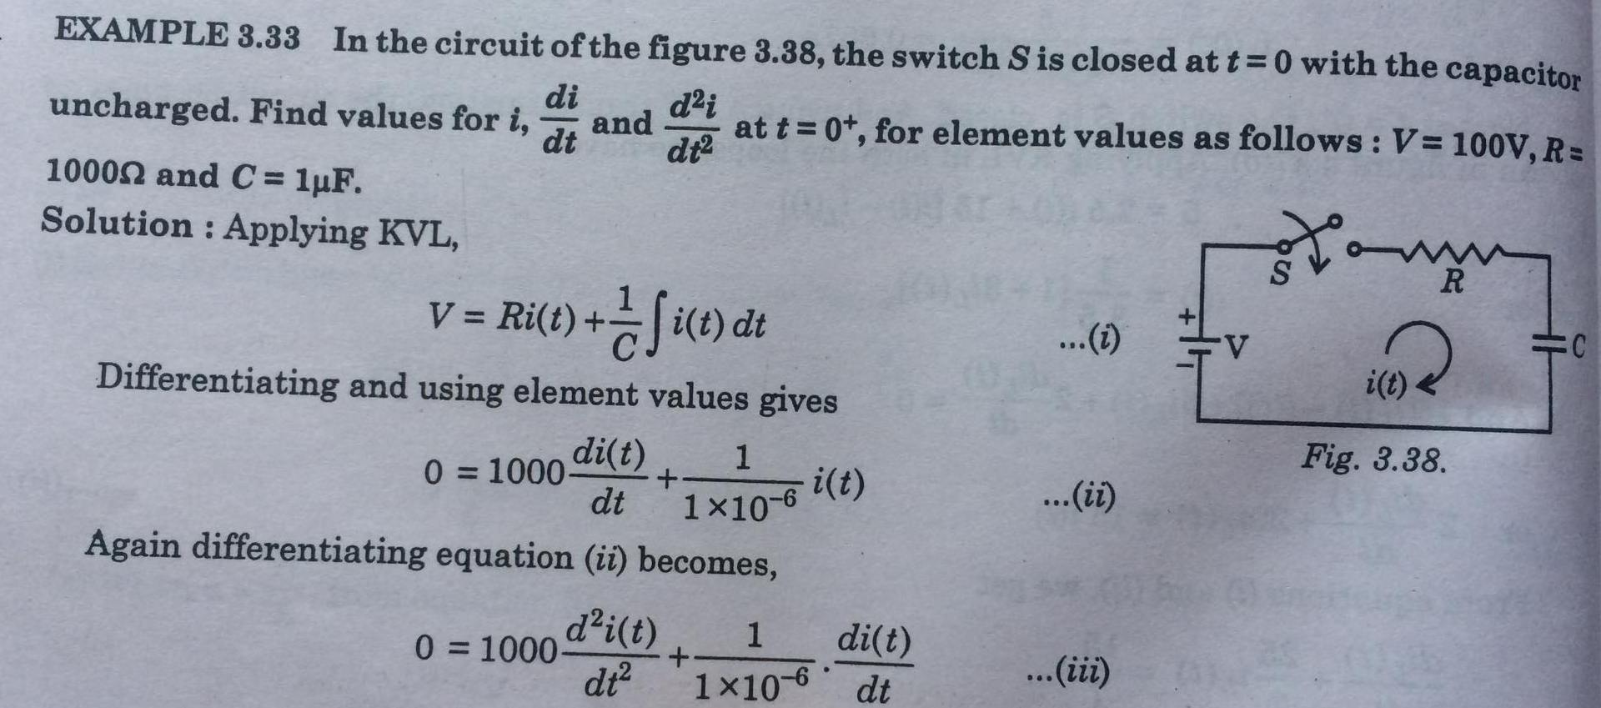
Initial Conditions_ Solutions Conti…

Slide 17
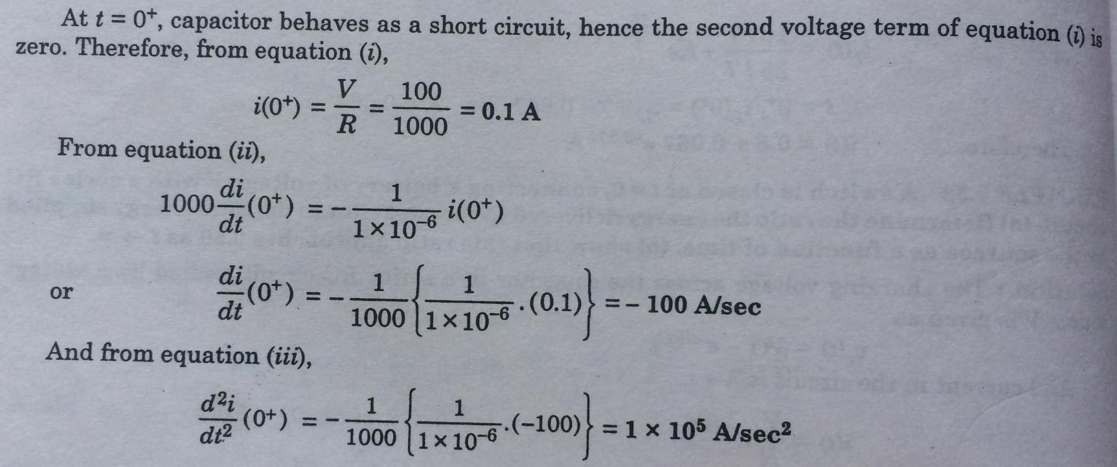
Initial Conditions_ Solutions Conti…

Slide 18
Thank YOU!!!

